Slide 1


Bank Loan Project
Project Name:- P599 Bank Loan Analytics
Group No:- 6
Kasani Siva Tarun Kumar
Dobariya Ankur
Aditya Raju Pawar
Aakash Manoj Barua
Boya Arun Kumar
Sheshank Naik

Slide 2
Content
Overview
Tools Used
Key KPI
Dashboard
Conclusion

Slide 3
Domain - Banking
OVERVIEW
This is Bank loan of Customers project where we were provided with 2 datasets with .csv extension files having 39k rows each and the objective was to analyze the growth that bank got within given years in loans.
This is Banking dataset of loan status. Its features allows viewing loan Status from multiple IDs : Loan status, loan amount, last payment date, Loan Issue date , Home ownership ,Grade & Sub-grade, interest rate
We used MS-Excel, MySQL for analyzing, cleaning and removing duplicates from dataset and prepared dashboard using Tableau and PowerBI tools where we did calculations, merging and prepared interactive dashboards.

Slide 4

TOOLS USED
Excel
Power Bi
MySQL
Tableau

Slide 5
Key KPI’s
1. Year wise Loan Amount Stats.
2. Grade and Sub_Grade wise Revolving Balance.
3. Total Payment for Verified Status Vs Total Payment for Non Verified Status
4. State wise and Month wise Loan Status.
5. Home Ownership Vs Last Payment date Stats.

Slide 6
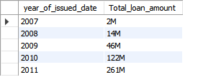
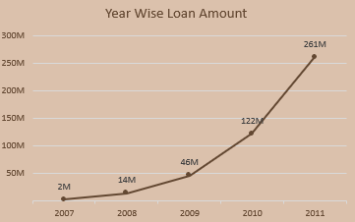
1. Year Wise Loan Amount Stats
By observing the chart we can see how Loan Amount is increasing by year.
Starts from 2007 the loan amount is 2M and in the 2011 the loan amount is 261M. We can subtract the new value to the old value to see the difference
261M – 2M = 259M.
In 2007 Loan Amount Was 2M After 4 Years The Loan Amount Has Been Increased Rapidly Till 259M
And The Grand Total 261M

Slide 7
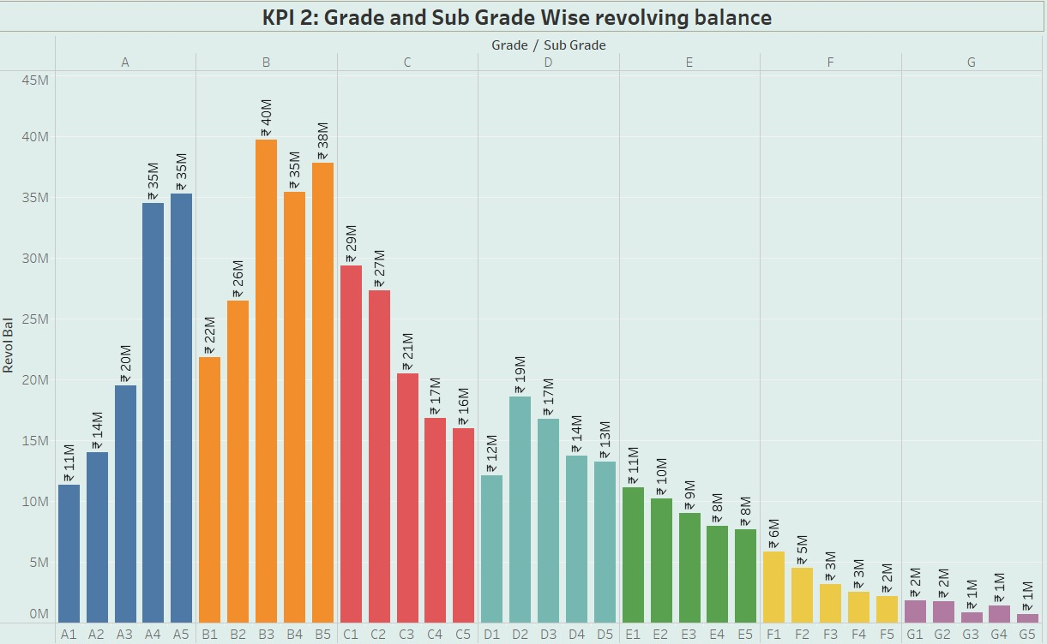
2. Grade And Sub-Grade Wise Revol Balance
In this Grade and subgrade wise revol balance we can notice Grade-B have more revol balance then any other grade & Grade-G have very low revol balance.
As we can see that Grade B customers has higher annual income for 10+ yrs of employment period, so higher the annual income lower the Debt to income ratio and hence, more number of customers took loan in Grade B .
Similar, it goes for other grades also B>A>C>D>E>F>G order for revol bal as per annual income

Slide 8
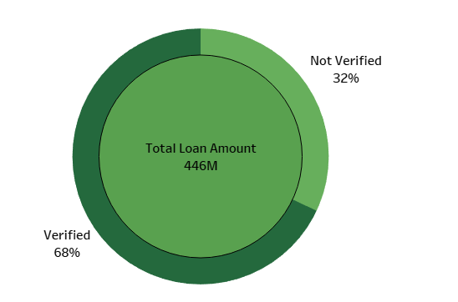
3. Total Payment for Verified Status Vs Total Payment for Non Verified Status
This is the first stage of the verification process. The bank needs a loan application to initiate the document collection and verification process
Looking at pie chart we can observe that verified status have 68% of total payment and 32% of total payment which are Not Verified for the Loan Amount

Slide 9
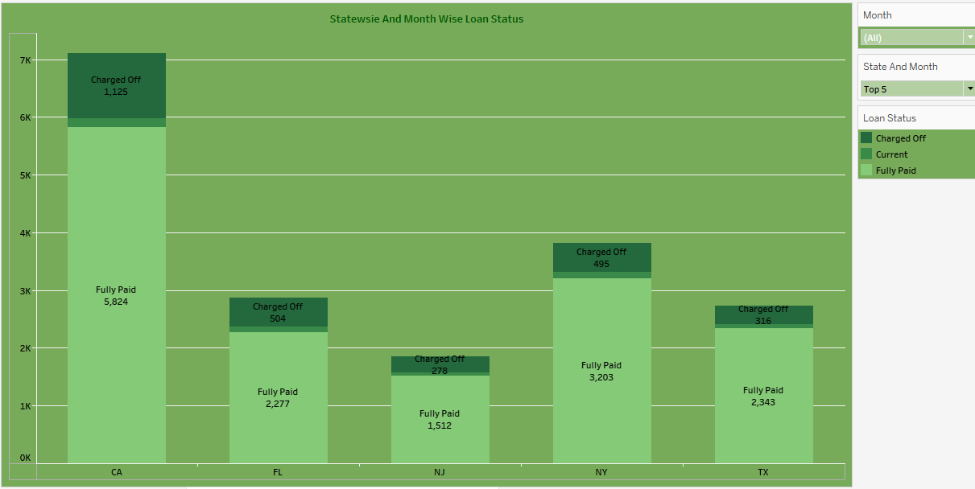
4. State wise and month wise loan status
We Are Calculating State Wise And Month Wise Loan Status.
The Loan Status Are
1.Charged Off
2. Current.
3 Fully Paid
We Have Added Slicer For The State And Month For Individually Selection Also We Have Added Top 5 And Top 10 Filter According To The State
In Top 5 States We Can See The Charged Off And Fully Paid Loan Status Are More And The Top 1 State Is California

Slide 10
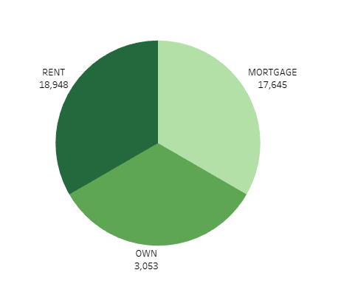
5. Home ownership Vs last payment date stats
The right graph shows the Home ownership and the amount paid for each on last payment date.
Here, we can see that maximum latest Count by customers is in RENT home ownership That is 18,948.
Here, we can see that minimum latest Count by customers is in OWN home ownership That is 3053

Slide 11
DASHBOARD

Slide 12
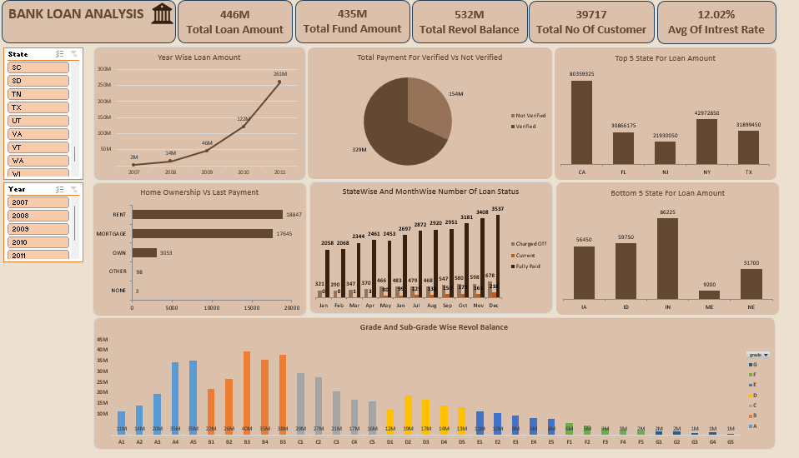
Excel Dashboard

Slide 13
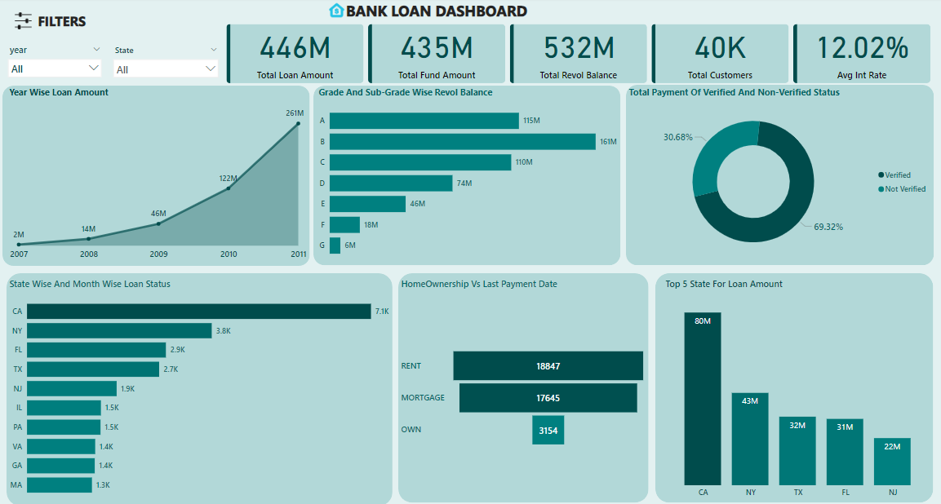
Power BI Dashboard

Slide 14
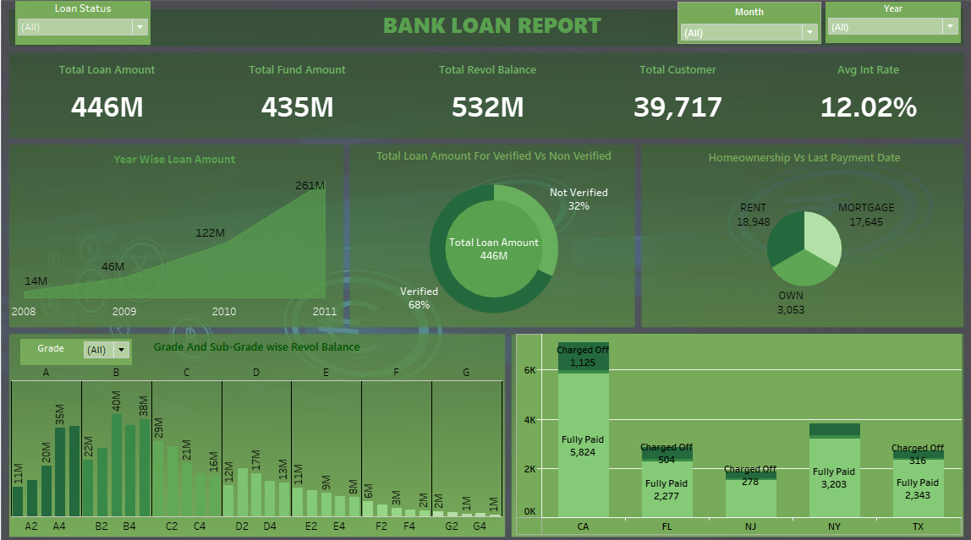
Tableau Dashboard

Slide 15
CONCLUSION
We can reduce the rate of interest in some of the states where number of customers is very low so that the number of customers can increase.
Once number of customers gets increased at a certain limit where bank will not get in loss. We can slightly increase the rate of interest so that bank will generate a good revenue from the interest.
grade` A´ to grade `B´ it move upwards after grade B it moves diminishing till Grade `G´.
The bank should increase the count of verified members as now not verified customers are maximum as compared to verified customers
that is verified members = 22.80 K & Not verified = 16.92 K
If the bank increase the rate of interest for not verified members, then the not verified members automatically shifted to verified members

Slide 16
THANK YOU

